Slide 1
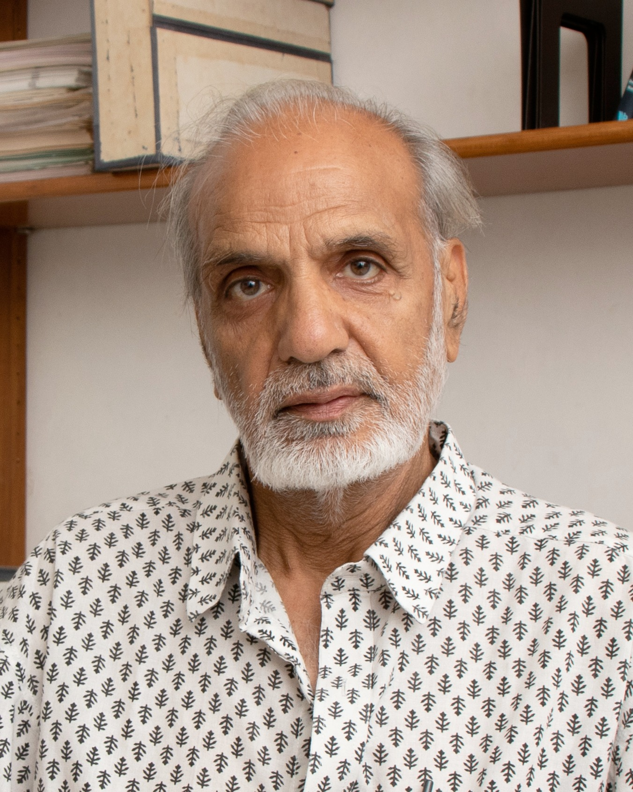
Remembering
Prof. Naresh Dadhich …
Notes:
Professor Naresh Dadhich was an eminent theoretical physicist whose work in general relativity and gravitation theory left a profound impact on the scientific community. Born in Rajasthan, India, he rose from humble beginnings to become a globally respected scholar and leader. His career spanned decades of research, teaching, and institution-building, most notably as co-founder and director of the Inter-University Centre for Astronomy and Astrophysics (IUCAA). This presentation pays tribute to his life, achievements, and legacy, highlighting his contributions to science and society. It also reflects on his role as a mentor, activist, and thinker who bridged the gap between scientific inquiry and social responsibility.

Slide 2
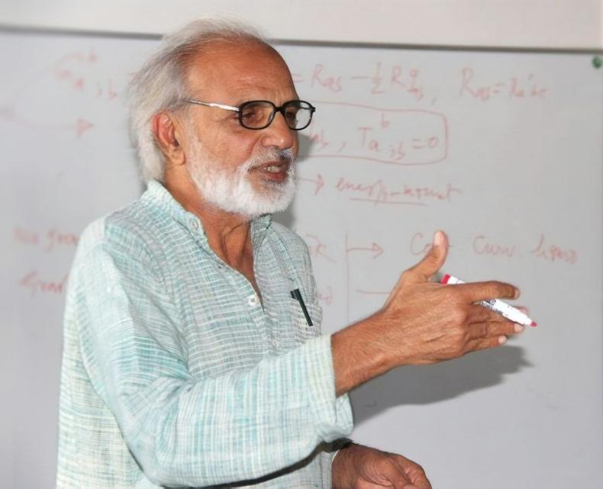

A general relativist with significant contribution to gravitational research.
Co-founder and former director of the Inter-University Center for Astronomy and Astrophysics (IUCAA), Pune, India.
Mentored generations of theoretical physicists and connected science with social responsibility and activism.
Notes:
Professor Naresh Dadhich was an eminent theoretical physicist whose work in general relativity and gravitation theory left a profound impact on the scientific community. Born in Rajasthan, India, he rose from humble beginnings to become a globally respected scholar and leader. His career spanned decades of research, teaching, and institution-building, most notably as co-founder and director of the Inter-University Centre for Astronomy and Astrophysics (IUCAA). This presentation pays tribute to his life, achievements, and legacy, highlighting his contributions to science and society. It also reflects on his role as a mentor, activist, and thinker who bridged the gap between scientific inquiry and social responsibility.

Slide 3
Early Life and Education
Prof. Dadhich hailed from a village in interiors of Rajasthan, India.
He pursued BSc at Birla Institute of Technology and Science (BITS), Pilani and earned MSc from Vallabh Vidyanagar College (Gold Medal under Sardar Patel University).
He earned his doctorate from the University of Poona, India under Prof. V.V. Narlikar, focusing on gravitation and cosmology.
Notes:
Naresh Dadhich was born on September 1, 1944, in Sarsali village, Churu district, Rajasthan. His early life was marked by perseverance, as he traveled miles daily to attend school due to the lack of educational facilities in his village. He pursued higher education at BITS Pilani and Vallabh Vidyanagar, later earning a Ph.D. in General Relativity from the University of Pune under the guidance of Professor V.V. Narlikar. This academic foundation laid the groundwork for his lifelong dedication to theoretical physics, particularly in gravitation and cosmology. His journey from a rural setting to international recognition exemplifies determination and intellectual curiosity.

Slide 4
Professional journey
He started at University of Poona as a Lecturer in 1971 and over the years compiled a very productive team of researchers and students in GR and Cosmology.
In 1988 he founded IUCAA with Profs. J. V. Narlikar and A. Kembhavi where he became the 2nd Director in 2003-2009.
He held the M. A. Ansari Chair at CTP, Jamia Millia Islamia, New Delhi in 2012-2016.
He was also visiting member of the University of KwaZulu-Natal, RSA, Portsmouth, UK and Bilbao, Spain.
Notes:
Naresh Dadhich was born on September 1, 1944, in Sarsali village, Churu district, Rajasthan. His early life was marked by perseverance, as he traveled miles daily to attend school due to the lack of educational facilities in his village. He pursued higher education at BITS Pilani and Vallabh Vidyanagar, later earning a Ph.D. in General Relativity from the University of Pune under the guidance of Professor V.V. Narlikar. This academic foundation laid the groundwork for his lifelong dedication to theoretical physics, particularly in gravitation and cosmology. His journey from a rural setting to international recognition exemplifies determination and intellectual curiosity.

Slide 5
Scientific impact
Prof. Dadhich contributed profoundly in brane world cosmologies, gravitational collapse, wormholes and the astrophysics of black holes, higher-dimensional gravity (Lovelock Gravity).
He authored 200+ research papers in various impactful journals collaborating across the Globe.
He co-evolved IUCAA into a world-renowned research center and led it to influence young researcher across Indian Universities.
He was active with LIGO-India, Southern African Large Telescope and Thirty Meter Telescope project and took part in international efforts like MALS, LADUMA and HIRAX.
Notes:
Naresh Dadhich was born on September 1, 1944, in Sarsali village, Churu district, Rajasthan. His early life was marked by perseverance, as he traveled miles daily to attend school due to the lack of educational facilities in his village. He pursued higher education at BITS Pilani and Vallabh Vidyanagar, later earning a Ph.D. in General Relativity from the University of Pune under the guidance of Professor V.V. Narlikar. This academic foundation laid the groundwork for his lifelong dedication to theoretical physics, particularly in gravitation and cosmology. His journey from a rural setting to international recognition exemplifies determination and intellectual curiosity.

Slide 6
Honors and Achievements
Honorary Research Professor title by University of KwaZulu-Natal, RSA.
Fellow of Indian Academy of Sciences and National Academy of Sciences India.
Won the C. V. Raman award.
Multiple Honorable Mentions from Gravity Research Foundation
Notes:
Naresh Dadhich was born on September 1, 1944, in Sarsali village, Churu district, Rajasthan. His early life was marked by perseverance, as he traveled miles daily to attend school due to the lack of educational facilities in his village. He pursued higher education at BITS Pilani and Vallabh Vidyanagar, later earning a Ph.D. in General Relativity from the University of Pune under the guidance of Professor V.V. Narlikar. This academic foundation laid the groundwork for his lifelong dedication to theoretical physics, particularly in gravitation and cosmology. His journey from a rural setting to international recognition exemplifies determination and intellectual curiosity.

Slide 7
Further…
Popularized Physics across the length and breadth of India.
Promoted public engagement and lectures to bridge science and society for better understanding.
Advocated for sustainable development and actively participated in local environmental movements.
Notes:
Naresh Dadhich was born on September 1, 1944, in Sarsali village, Churu district, Rajasthan. His early life was marked by perseverance, as he traveled miles daily to attend school due to the lack of educational facilities in his village. He pursued higher education at BITS Pilani and Vallabh Vidyanagar, later earning a Ph.D. in General Relativity from the University of Pune under the guidance of Professor V.V. Narlikar. This academic foundation laid the groundwork for his lifelong dedication to theoretical physics, particularly in gravitation and cosmology. His journey from a rural setting to international recognition exemplifies determination and intellectual curiosity.

Slide 8
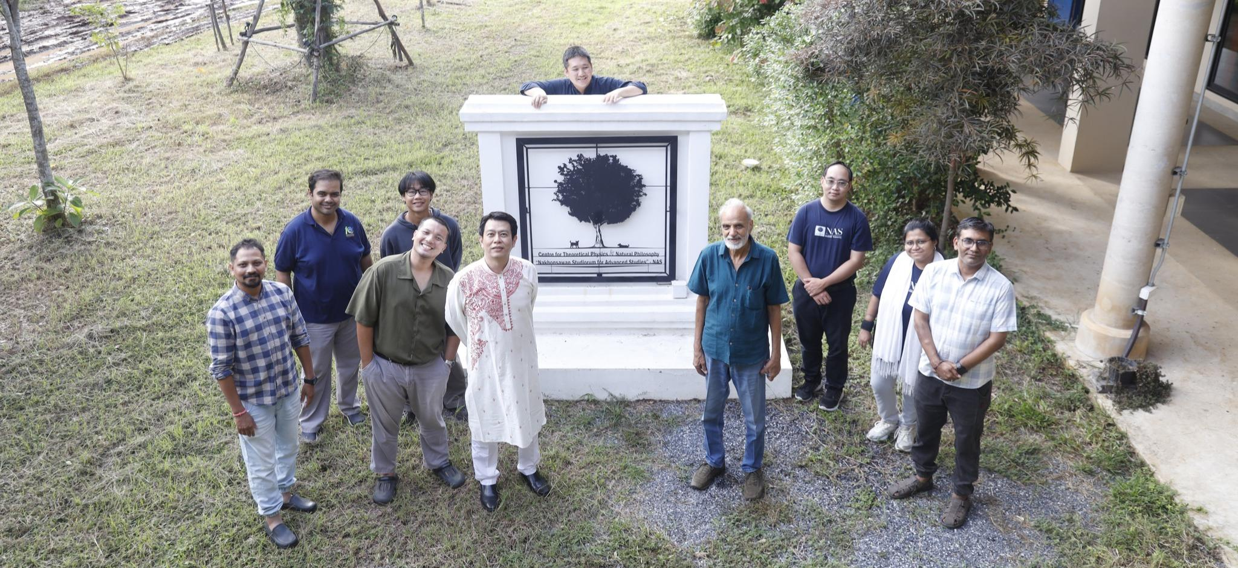
He visited us earlier this year in mid-October…
Inspired and left with many fond memories…
And with an invaluable legacy…
Notes:
Professor Naresh Dadhich's legacy is defined by his role as a scientist, mentor, and visionary. He was instrumental in establishing IUCAA as a premier research institute, shaping its mission and infrastructure. His intellectual contributions continue to inspire research in gravitation and cosmology, while his advocacy for science communication and environmental stewardship underscores his holistic approach to knowledge. Remembered as a thinker who bridged science and philosophy, his life serves as a testament to the power of curiosity, integrity, and social engagement in shaping a better world.

